Slide 1

DEPARTMENT OF
CSE (ARTIFICIAL INTELLIGENCE AND MACHINE LEARNING)
ACADEMIC YEAR 2025 - 2026
SEMESTER III
ARTIFICIAL INTELLIGENCE LABORATORY
MINI PROJECT REVIEW
NUMBER GUESSING GAME
REGISTER NUMBER | 2117240030015
NAME | AVANINDH SUGUNAN.A
YEAR | 2ND YEAR
SECTION | A
FACULTY IN-CHARGE | Mrs. M. Divya

Slide 2
PROBLEM STATEMENT
Artificial Intelligence enables machines to make decisions, solve problems, and adapt through logic and learning. This project demonstrates how AI can solve a maze using pathfinding algorithms.
The Maze Solver Game showcases how an AI can navigate a complex environment using reasoning and feedback, applying search algorithms to find the optimal path from start to goal.
PROBLEM STATEMENT:
To design a maze game where an AI or player can navigate from a start point to an end point using logical movement and pathfinding algorithms.
EXPECTED RESULT:
The maze is randomly generated and always solvable.
The player can manually navigate the maze.
The game includes visual feedback, sound effects, and a win condition.
Future versions may include AI auto-solving or hint systems.

Slide 3
THEORETICAL BACKGROUND
This project is based on recursive backtracking for maze generation and Breadth-First Search (BFS) for pathfinding.
Maze Generation: Recursive backtracking carves paths by visiting cells and removing walls, ensuring a solvable maze.
Pathfinding (optional): BFS finds the shortest path from start to end by exploring all reachable nodes level by level.
These algorithms demonstrate core AI concepts: reasoning, decision-making, and optimization.
LITERATURE SURVEY
Recursive Backtracking: Guarantees solvable mazes with randomized paths.
Breadth-First Search (BFS): Finds shortest path in unweighted grids; ideal for hint systems.
Depth-First Search (DFS): Explores deeply before backtracking; useful for maze generation.
A Search (Advanced):* Combines path cost and heuristic for efficient solving.
Reinforcement Learning (Future): Can learn optimal paths through trial and error.

Slide 4
IMPLEMENTATION AND CODE
Link to code in Git-hub Repository
List | Git-hub Repository Links
Implementation of Code Link | https://github.com/avanindh2-sudo/aiminiproject
Word Document Report Link | https://github.com/avanindh2-sudo/aiminiproject
PPT Link | https://github.com/avanindh2-sudo/aiminiproject

Slide 5
OUTPUT AND RESULTS
Results:
Maze is generated randomly and is always solvable.
Player can navigate using arrow keys.
Win condition triggers sound and message.
Restart option allows replay without closing the game.
Future Enhancements:
Add AI auto-solver using BFS or A*
Include difficulty levels and timer
Add GUI buttons and animations
Track player performance and stats

Slide 6
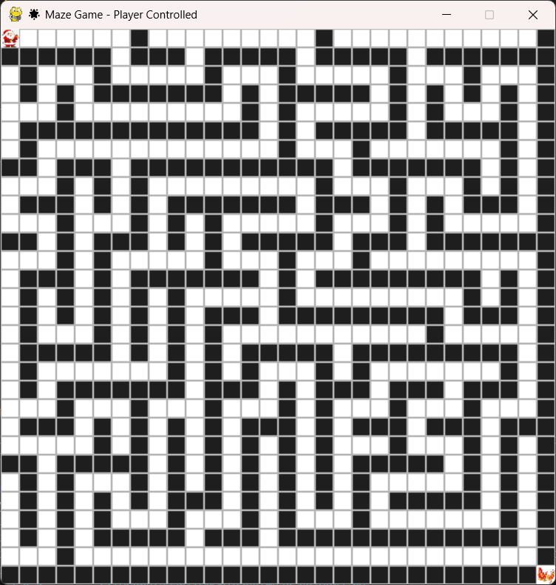
OUTPUT AND RESULTS
OUTPUT:

Slide 7
REFERENCES
Book:
“Programming Game AI by Example” by Mat Buckland – for practical AI techniques in game environments, including pathfinding and decision-making.
Website:
Red Blob Games – “Maze Generation Algorithms” (https://www.redblobgames.com/) – interactive visualizations and explanations of maze generation and solving techniques.
Blog:
Amit’s Game Programming Blog – “Maze Algorithms and Pathfinding” (https://www-cs-students.stanford.edu/~amitp/game-programming/) – detailed breakdowns of recursive backtracking, BFS, and A*.
Video:
“How to Generate and Solve Mazes” – YouTube channel The Coding Train – hands-on coding tutorials using Python and Pygame.

